Slide 1

Project Apollo
An open source oxygen concentrator

Slide 2


Project Apollo
Why
Ventilators need oxygen!
Typical FiO2 0.3 … 1
Oxygen generation is a big problem in developing countries.
No established infrastructure.
Oxygen bottles are expensive
People are already looking at alternative (local) ways for producing oxygen

Slide 3

Project Apollo
What is it
Goal = enabling people around the world to build the prototype ASAP
Focus = Simplicity and speed of build
Simple, reliable design (zeolite-based PSA system)
Flexible, open source, off-the-shelf materials
Very low cost (aspirational target = $200 for 15 liters/min @ 80%)
Final goal = Enable people to iterate and publish their own designs in the community

Slide 4
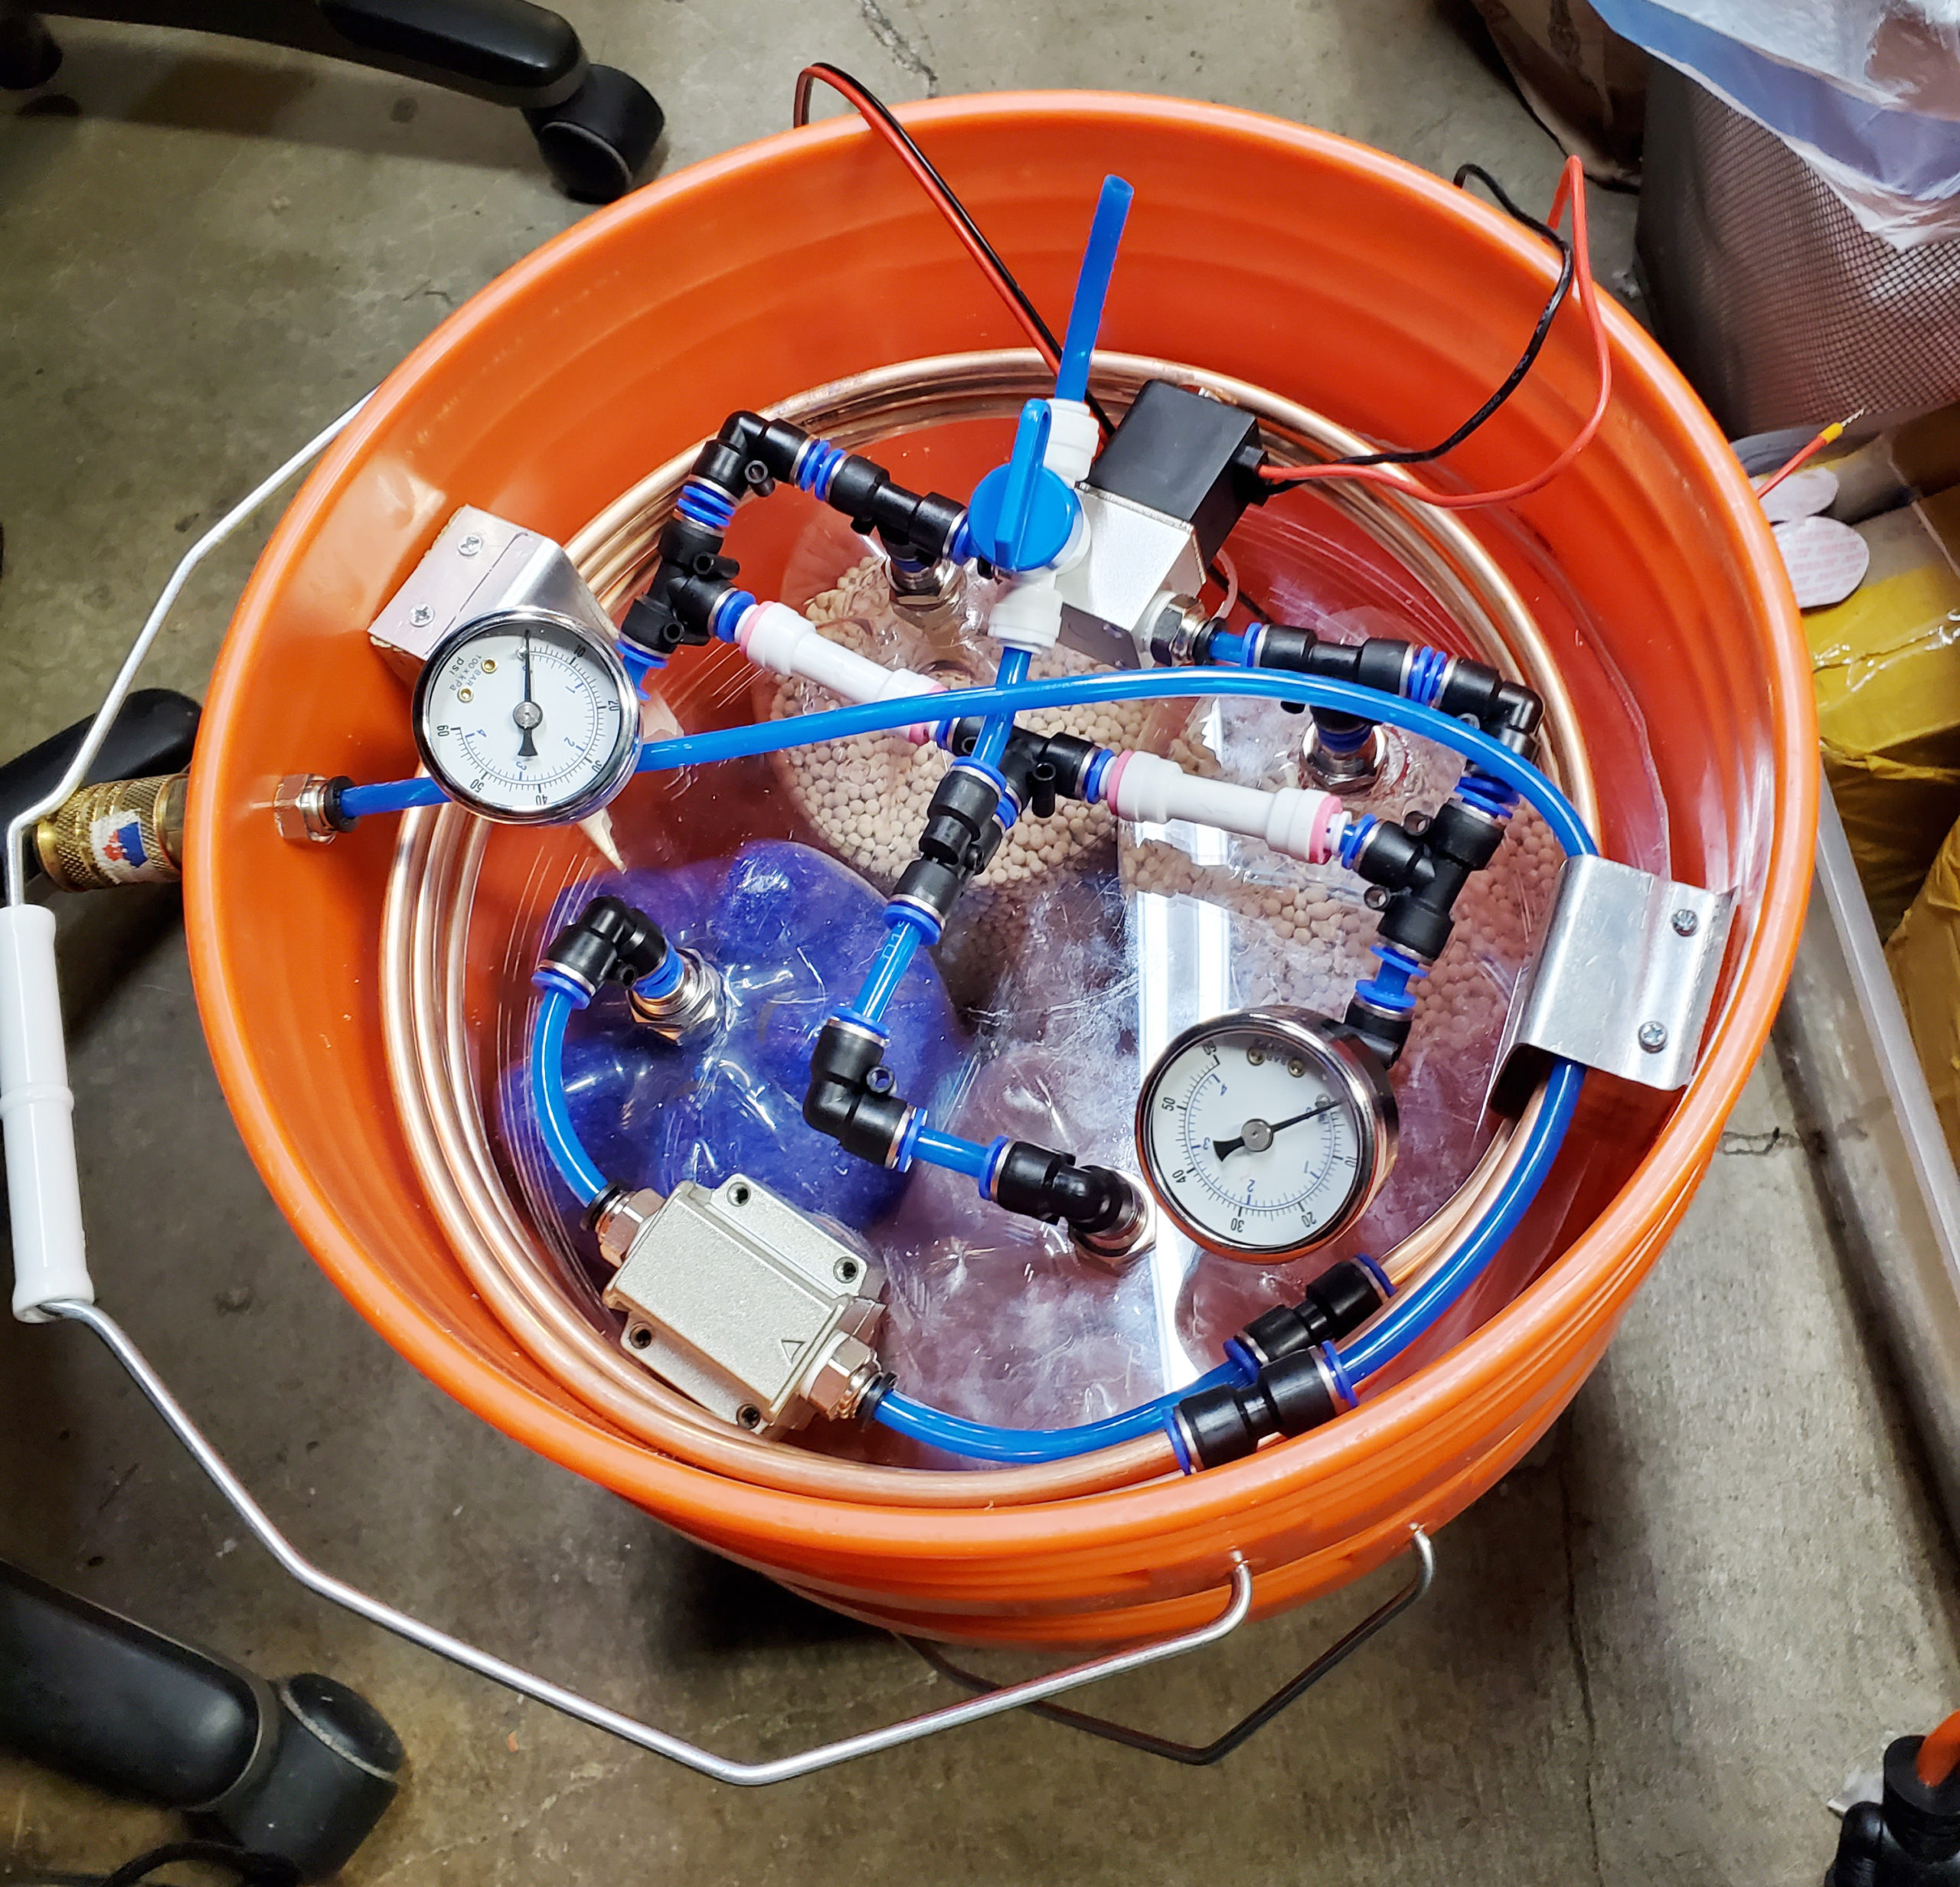
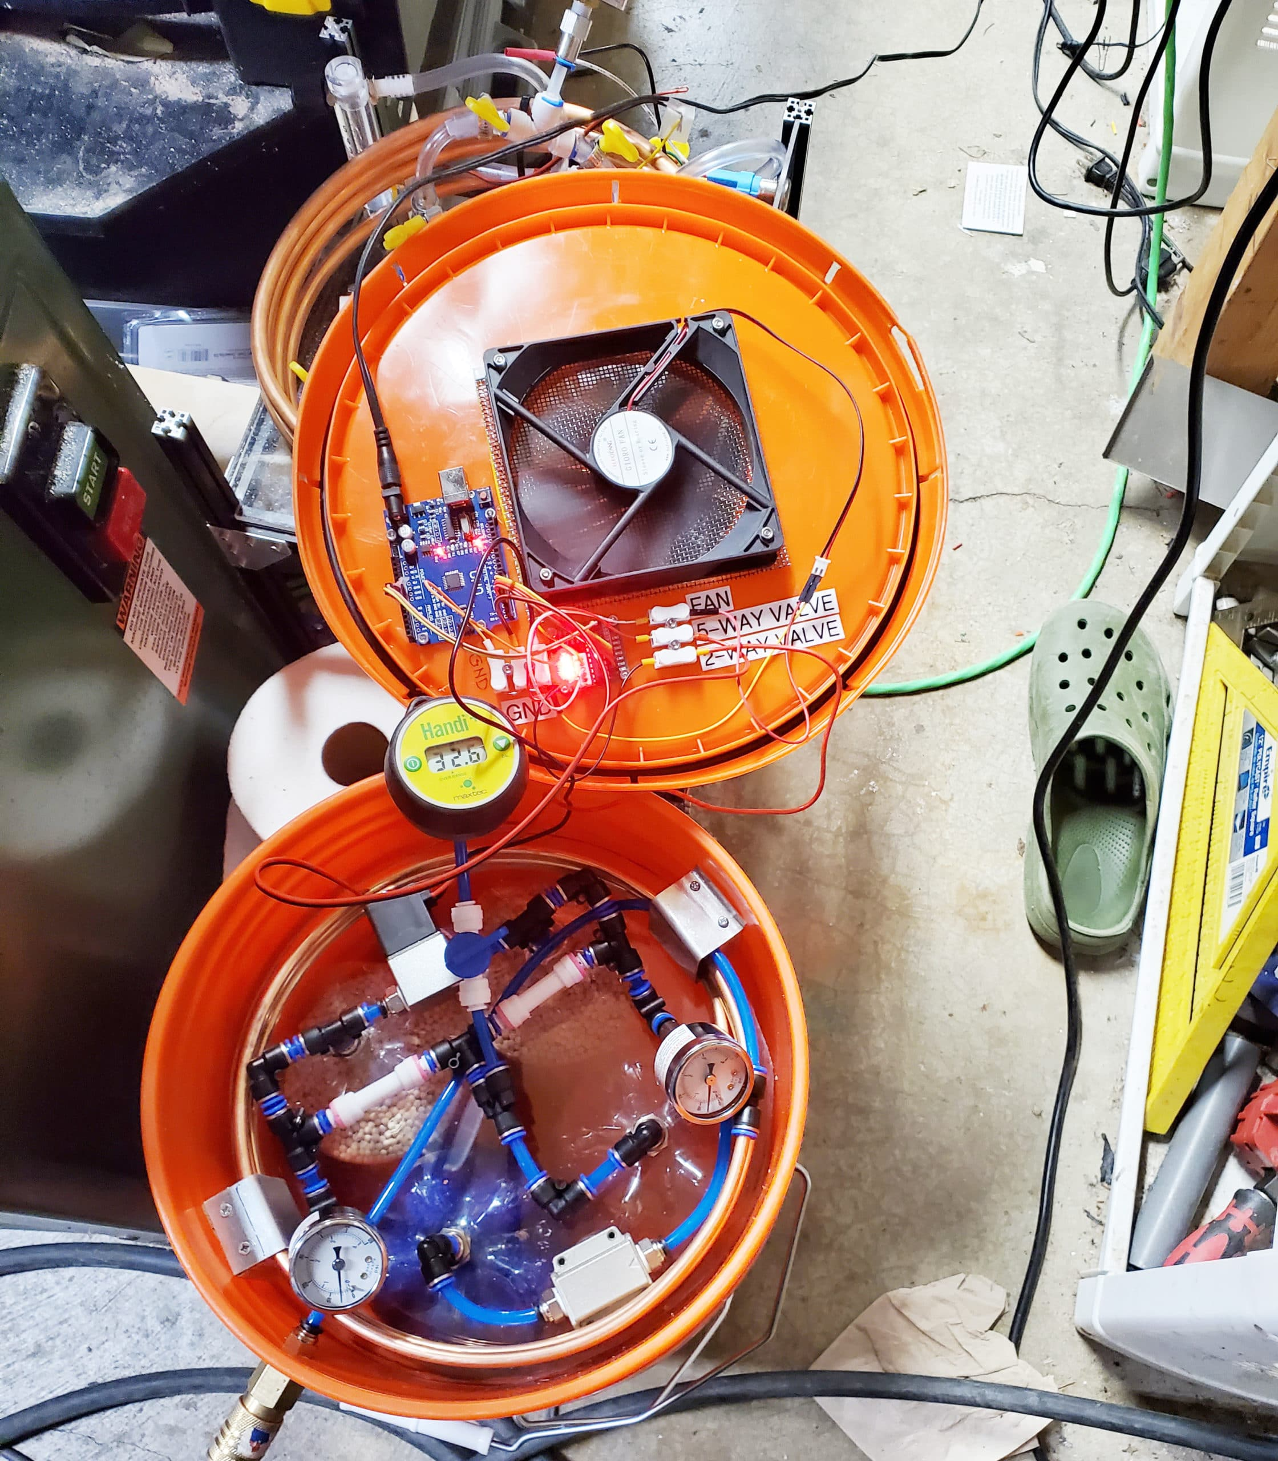
Project Apollo v2
How to build it
Follow the published build documentation
Buy/source the materials (check out the BOM)
Build the prototype
Validate O2 concentration and flow. Use a good reference O2 and flow sensor for calibration
Multiple iterations/variants have been built
O2 concentration 45 … 70%, 5 lpm

Slide 5

Project Apollo v4
Apollo Control Box v4
Focus = medical device
Safety: detect all failure scenarios
Ease of use: User experience and maintainability. Clear, actionable error messages
Self-regulating: Patient sensor/data feedback loop
Prototype: Self-contained control box
Touch screen for diagnostic messages, medical-grade buzzer
Open source, modular PCB design. Works with a variety of sensors
Self-tuning: valve timing, auto-adjusts to changes in compressed air input pressure, machine learning
Integration with SpO2 oximeter Bluetooth sensor
Cloud data integration for patient monitoring
Collaborations
Helpful Engineering, Public Invention, Oxikit, Microsoft Garage, Quick2space.org
Documentation, code
http://project-apollo.org

Slide 6
Thank you!

